Slide 1
Introduction to Data Structures and Algorithms in C++
Julien Nyambal

Slide 2
Compilation
g++: Invoke the GNU C++ compiler
-o: output file Compile and Link the code to create an executable called: outputfile.
-c: Compile and assemble, but do not link.
-Wall: Turns all the warnings that g++ will raise on
file1.cpp file2.cpp: A list of input C++ source files
Syntax:
g++ -std=c++11 -Wall file1.cpp file2.cpp -o main

Slide 3
Make
Reads instructions from Makefile
Will only compile the file that have changed
General structure Makefile
target: dependencies (files)
system command(s)

Slide 4
Make
Reads instructions from Makefile
Will only compile the file that have changed
General structure Makefile
target: dependencies (files)
system command(s)
Mind the tab!!

Slide 5
Make
CXX=g++ -std=c++11 -Wall -pedantic
all: main
main: file1.cpp file2.cpp file2.h
$(CXX) file1.cpp file2.cpp
file1 : file1.o file1.cpp file2.cpp file2.h
$(CXX) file1.o file2.cpp
file1.o: file1.cpp
$(CXX) -c -o file1.o file1.cpp

Slide 6
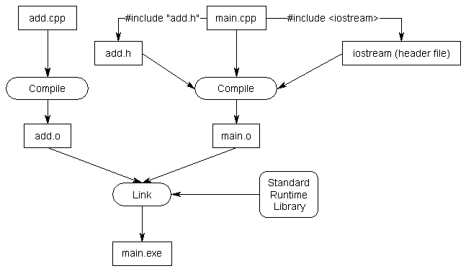
Linking

Slide 7
Linking
Let’s try this !

Slide 8
Data types
Type | Name | Minimum Size
bool | Boolean | 1 Bit
char | Character | 8 Bits
int | Integer | 16 Bits
long | Long Integer | 32 Bits
long long | Even Longer Integer | 64 Bits
float | Single Precision Floating Point Number | 6 Significant Digits
double | Double Precision Floating Point Number | 10 Significant Digits
Some examples?

Slide 9
Pointers
Pointers are variables, just like any other, except they always contain the memory address of another object/variable.
int myNumber;
myNumber = 25;
int*myPointer; Declaration of a pointer variable.
myPointer = &myNumber; Assigning the mem. address of myNumber to myPointer.
Adresses | 10001 | 10002 | 10003 | 10004
Values |  | 25 |  | nullptr
myNumber

Slide 10
Classes
They allow us to group variables and data together into a single object.
class example
{
// Access specifiers
public: (or private:)
// Data Members
string name;
// Member Functions()
void printname()
{
cout << “Name is: " << name;
}
//constructor
example(){}
//destructor
~example(){}
};

Slide 11
Static & Dynamic Allocation
Static memory is allocated at compile time, and gets stored in the Stack
int myNumbers[5]; 5 reserved memory spaces created at compilation
Dynamic memory is allocated at runtime, and get stored in the Heap
int* moreNumbers = new int[5];
Returns a memory address, and will allocate the
rest at run time
Scenario: Let’s assume that the user was an array of size 5, after prompt (int arr[size]). Static allocation can’t work since the array size can’t change at runtime. The new operator can work like int* arr = new int[size].
Always free dynamically allocated memory!

Slide 12
Next …
Arrays
Vectors

Slide 13
End !

